Slide 1
Matrix Methods in Data Analysis, Signal Processing, and Machine Learning
By Ariel Guerrero
ariel.guerrero@uc.edu.py
+595 (981) 425 040

Slide 2

Lecture 1: The columns space of A contains all vectors $Ax$
Independent columns = basis for the column space Rank = number of independent columns A=CR leads to: Row rank equals column rank
Related section in textbook: I.1

Slide 3
Lecture 1: The columns space of A contains all vectors $Ax$

Slide 4
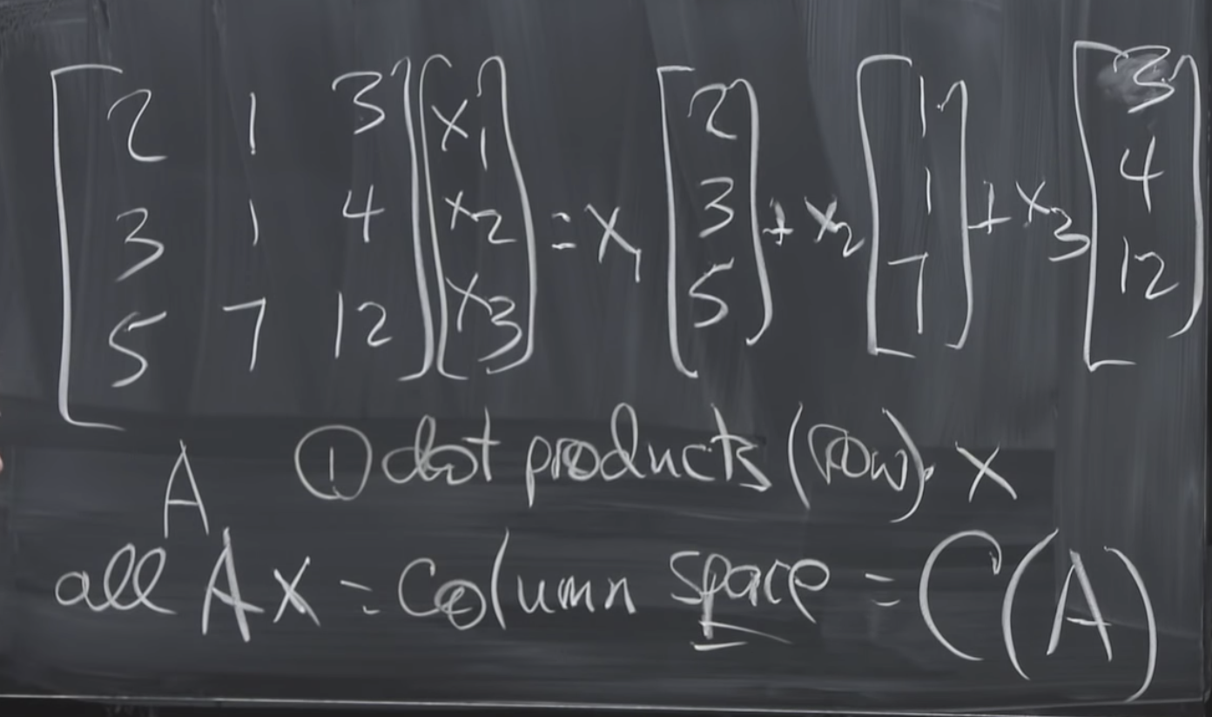
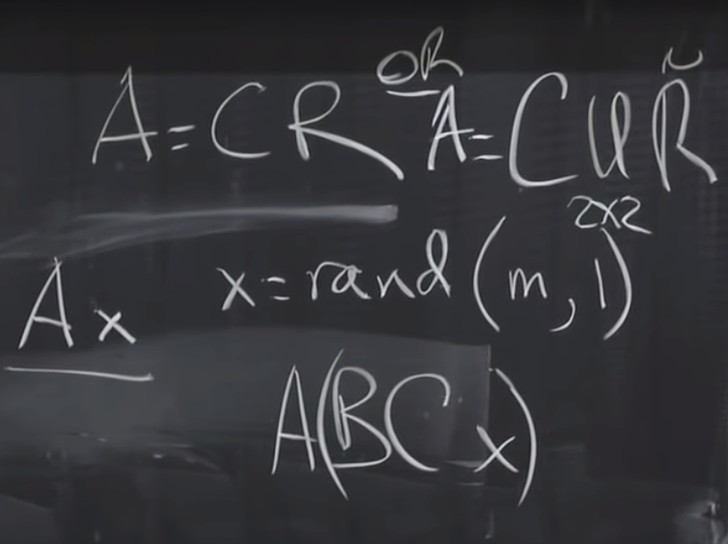
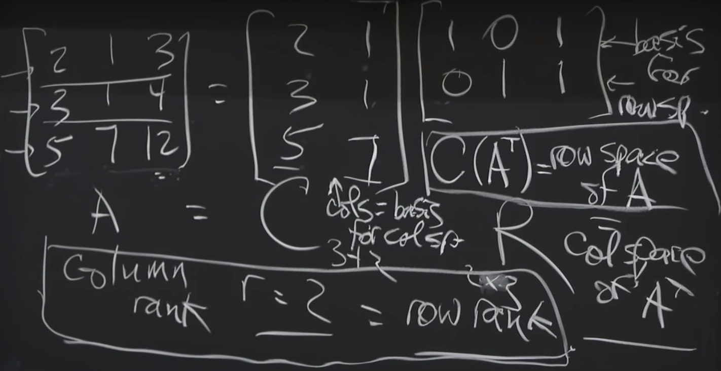
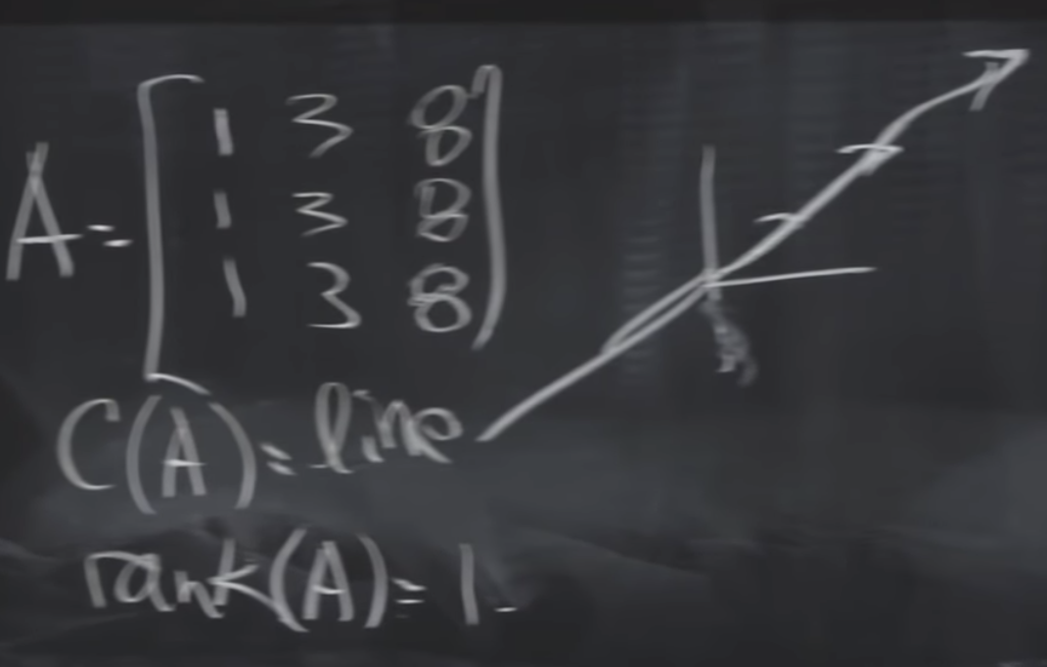
Lecture 1

Slide 5
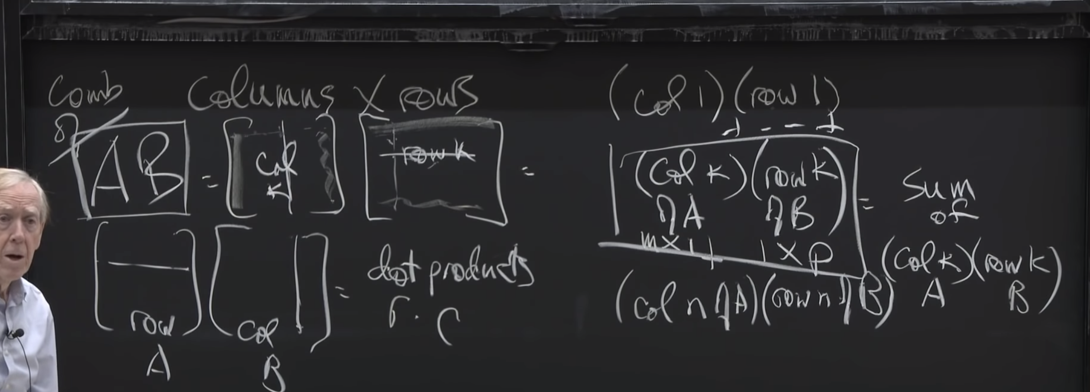
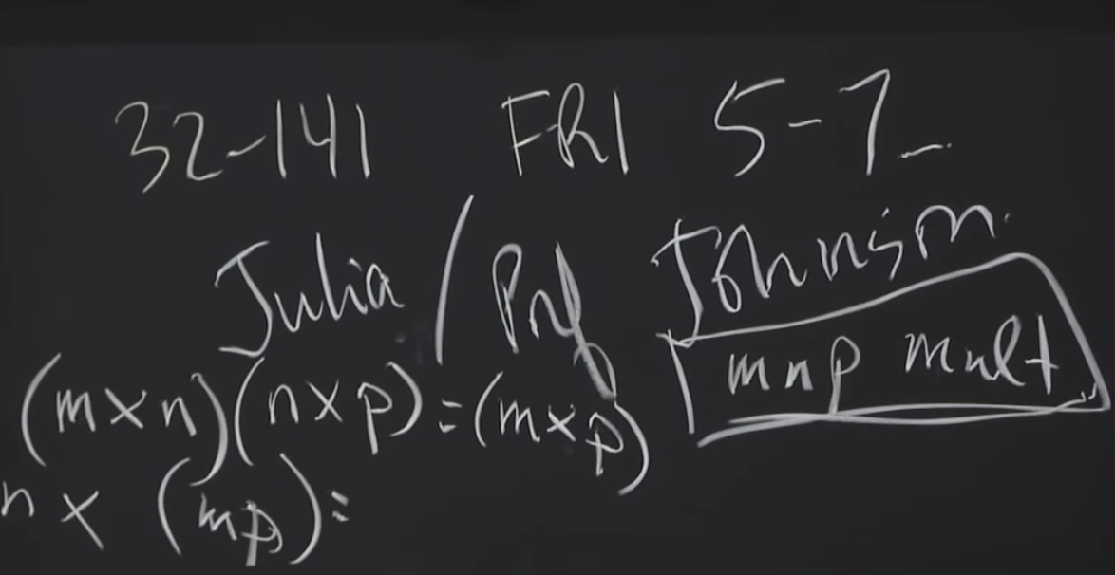
Lecture 1

Slide 6

Credits
https://github.com/aegiloru/lald
https://ocw.mit.edu/courses/mathematics/18-065-matrix-methods-in-data-analysis-signal-processing-and-machine-learning-spring-2018/index.htm
Gilbert Strang Web Site
http://www-math.mit.edu/~gs/
http://math.mit.edu/~gs/learningfromdata/

